Slide 1
Aviation Weather Safety
Roger Martin
National Weather Service
Wichita, KS
roger.martin@noaa.gov
Jason Anglin
National Weather Service
Great Falls, MT
jason.anglin@noaa.gov

Slide 2
Objectives
About the NWS, and the services we can provide
TAFs
Meteorology Pro Tips

Slide 3
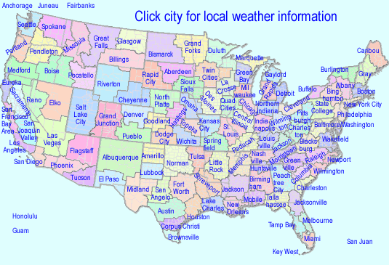
NWS Weather Forecast Offices
122 offices covering the U.S.
Build and maintain relationships with Local, State, and Federal Government entities
Provide expert advice to Emergency Managers
Solicit customer feedback on Products and Services
Conduct community awareness and education programs
Train volunteer observers and storm spotters

Slide 4
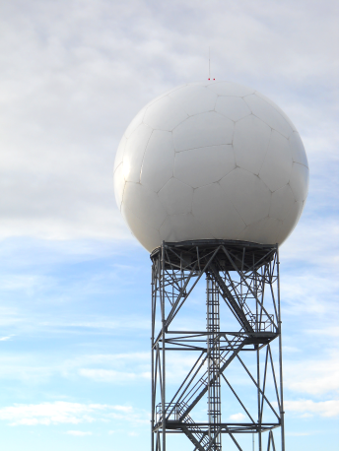
How We Operate
Continuous, 24-hr operation
Review suites of observations and model data
Routinely prepare and publish forecasts
Issue TAFs every 6 hours
Monitor radar in real-time, send warnings, maintain a web and social media presence
Inform local towers of impending hazardous weather (Airport Weather Warnings, phone calls)
Proactively seek severe weather reports, during and after hazardous weather events
Use feedback to evaluate performance
Balloon Launches:
11 Z and 23 Z

Slide 5
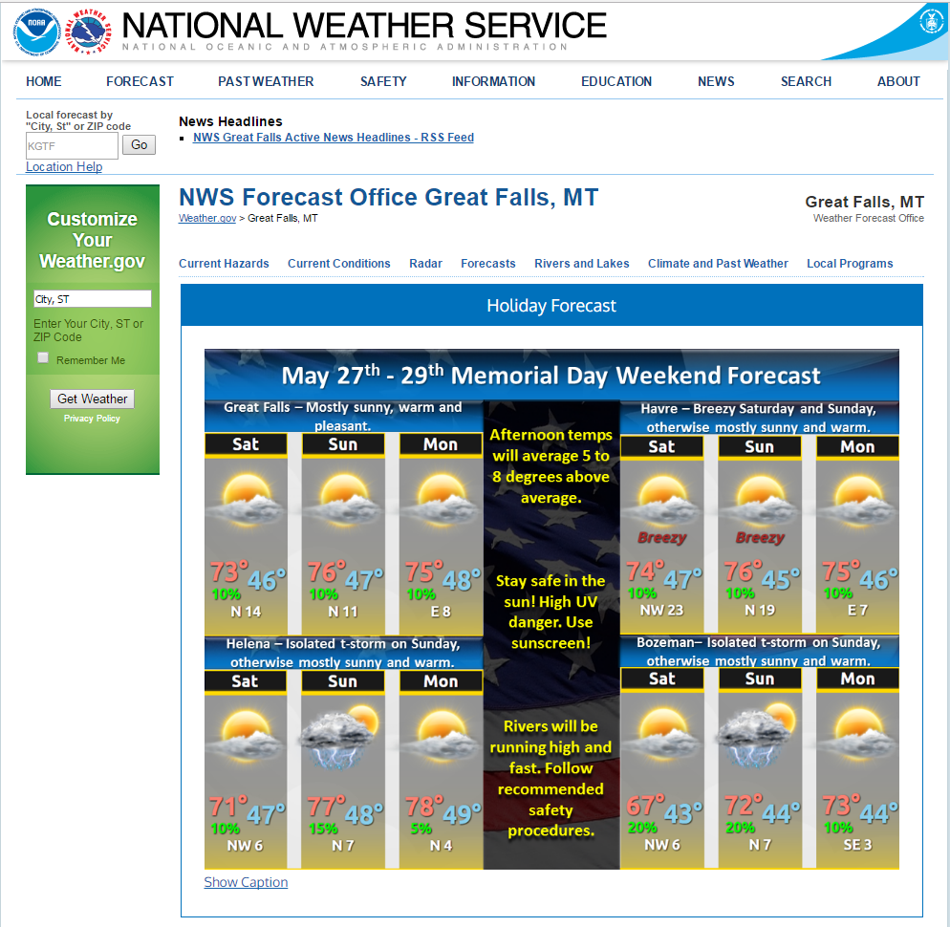
Useful Non-TAF Products
www.weather.gov/greatfalls

Slide 6
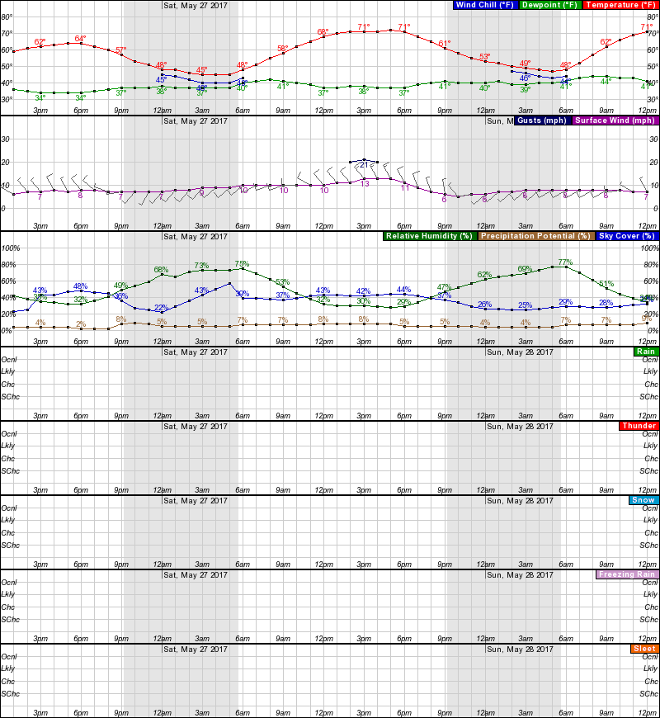
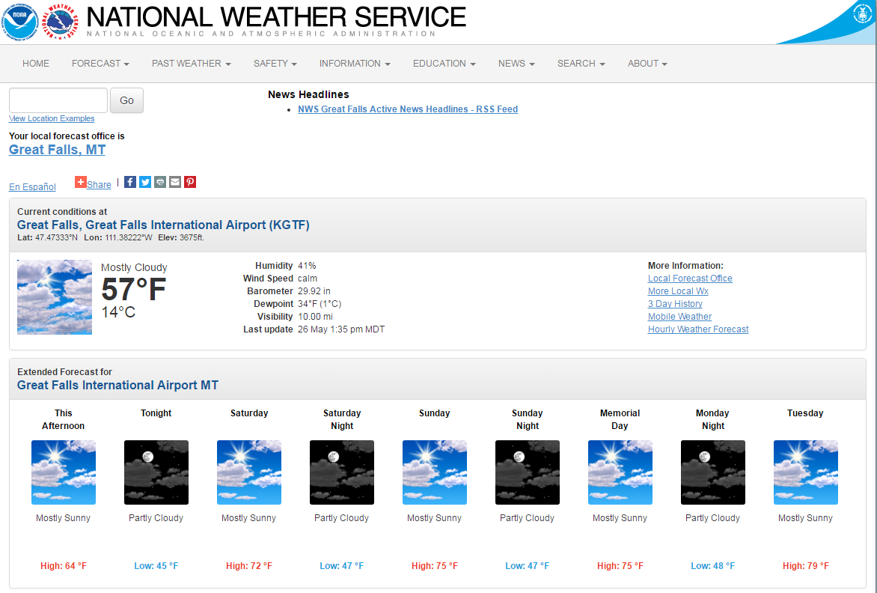
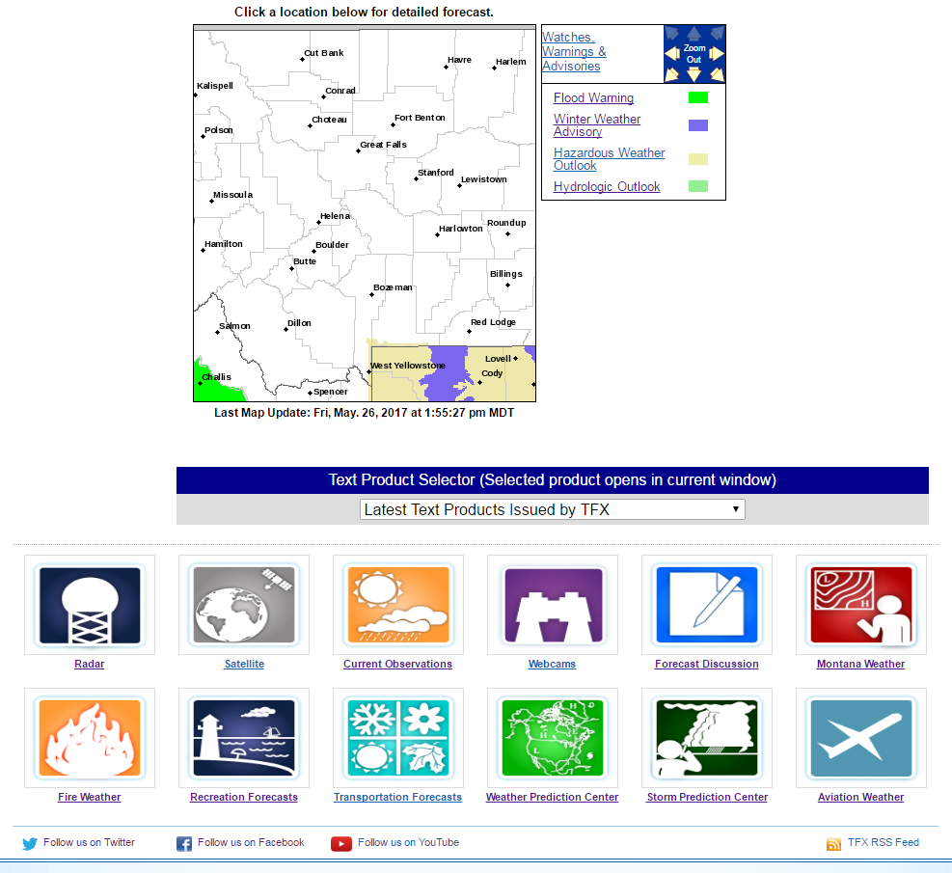
Useful Non-TAF Products
www.weather.gov/greatfalls

Slide 7
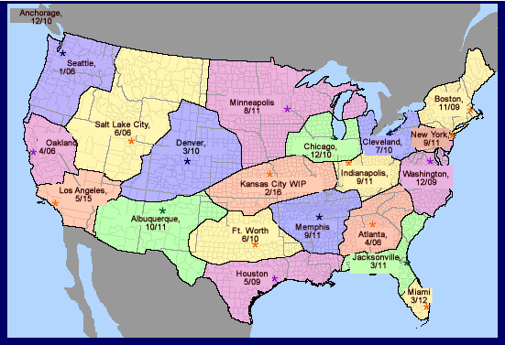
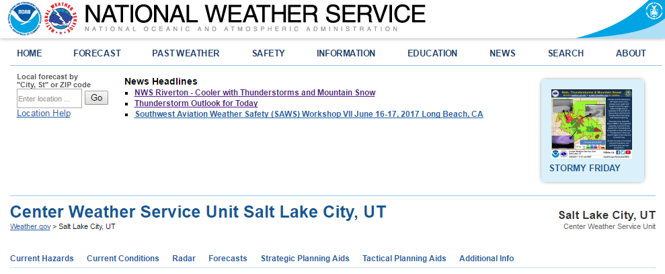
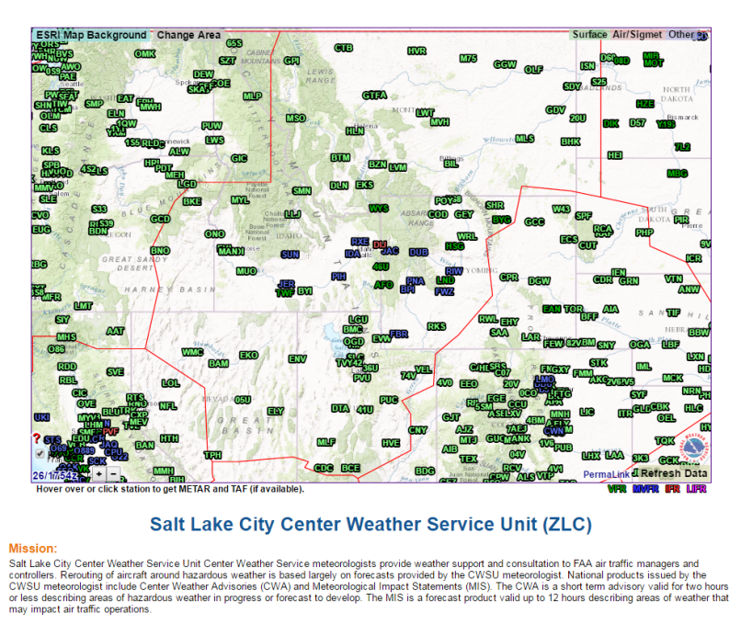
Center Weather Service Unit Offices
Face-to-face scheduled and on-demand briefings for air traffic controllers
Lead seasonal training to controllers and general aviation for aviation weather threats
Support for pilot emergencies and decision support services
Issue CWA (Center Weather Advisory) and/or MIS (Meteorological Impact Statement) as needed
Social Media via Facebook & Twitter

Slide 8
Center Weather Advisory (CWA)
An unscheduled weather advisory issued by CWSU meteorologists for ATC use to alert pilots of existing or anticipated adverse weather conditions within the next two hours
It’s not a flight planning product because of its short lead time and duration
Notes:
NOTE: Teach from slide.

Slide 9
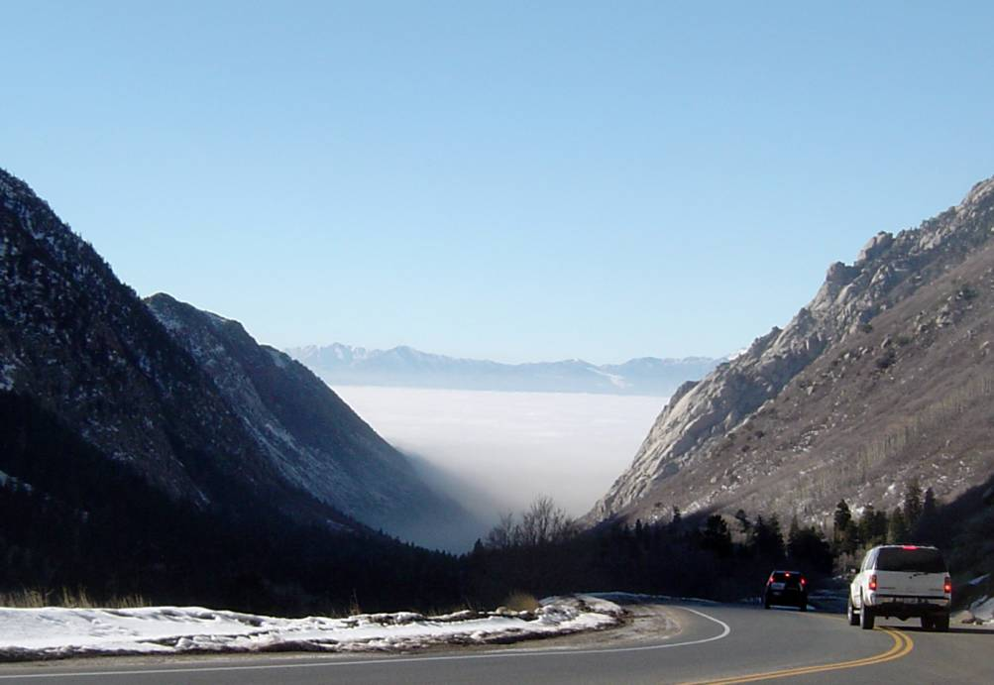
Meteorological Impact Statement (MIS)
An unscheduled discussion product that summarizes anticipated weather conditions with potential impact on air traffic flow control and flight operations in a ARTCC’s area of responsibility
Written for air traffic and support centers, not pilots
ZLC MISs can be issued for mountain waves, fog, strong downslope winds, or “backup”. This is being expanded to include larger weather systems with more significant impacts
Notes:
NOTE: Teach from slide.
◉ The MIS provides a unique plain language, non-technical description of weather expected to occur over an extended period ranging from several hours up to about two (2) days.
◉ A MIS is distributed to:
Air Route Traffic Control Center (ARTCC) personnel
− Including Traffic Management Unit (TMU) personnel
Other supported centers
A MIS is not intended to be used by pilots.

Slide 10
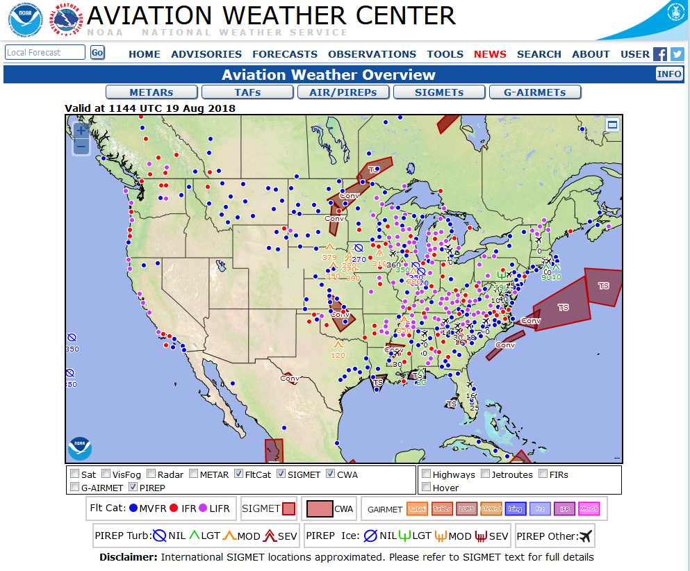
Aviation Weather Center
Located in Kansas City, MO there mission is to deliver consistent, timely, and accurate weather information for the world airspace system
Issue important airspace forecasts (AIRMETS) and hazardous airspace warnings (SIGMETS)

Slide 11
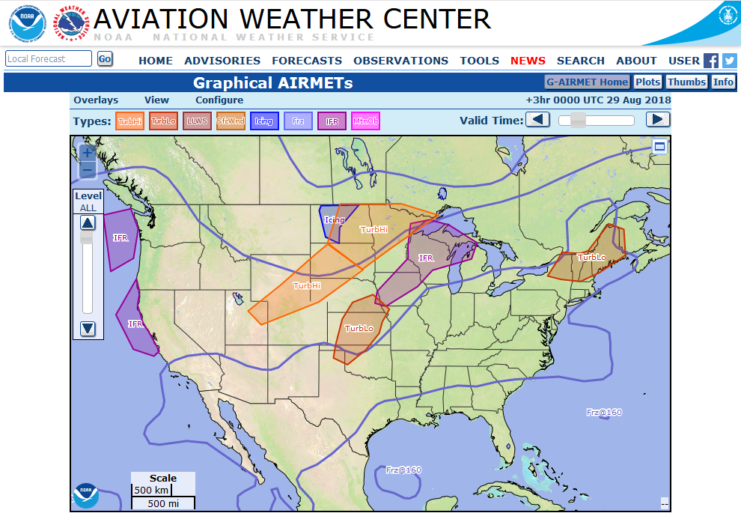
Aviation Weather Center
AIRMET – Advises of weather that maybe hazardous to aircraft
Includes IFR conditions (AIRMET Sierra), Turbulence (AIRMET Tango), and Icing (AIRMET Zulu)
Does not include convective activity

Slide 12
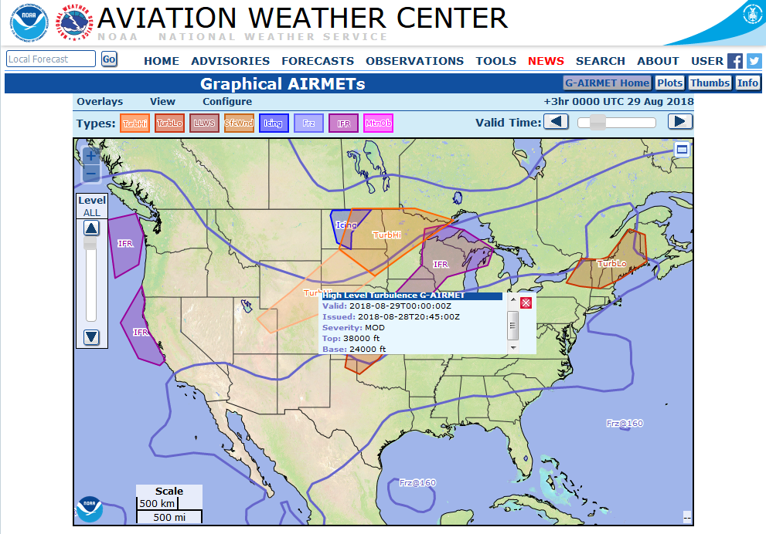
Aviation Weather Center
Must affect an area of at least 3000 square miles
Usually issued for 6 hour periods
Amended as necessary

Slide 13
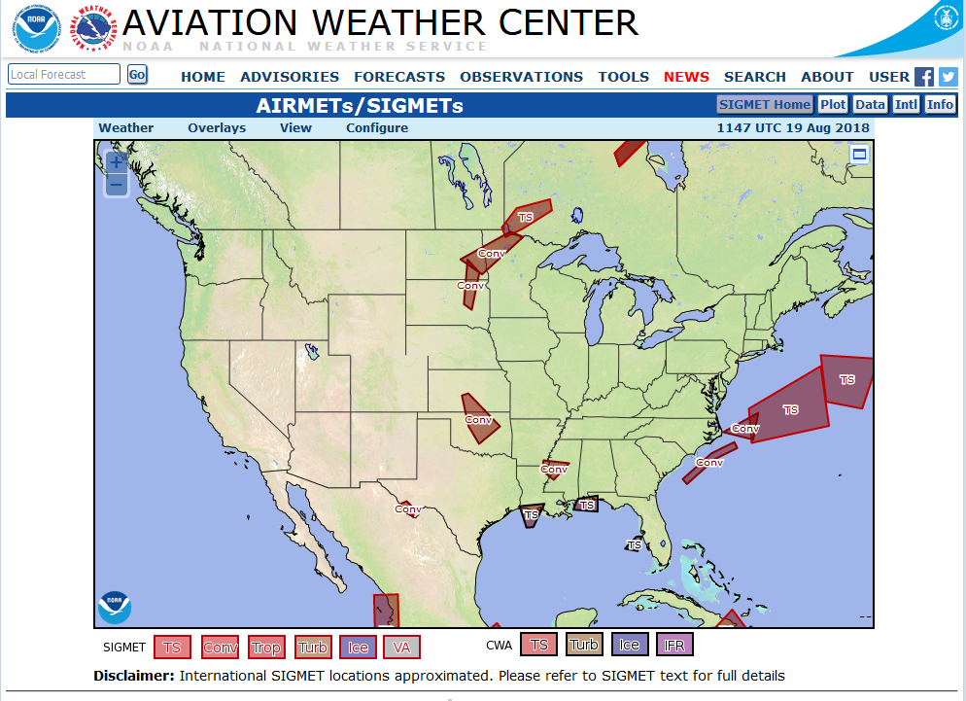
Aviation Weather Center
SIGMET – Advises of significant weather that is potentially dangerous to aircraft
Includes Severe Icing, Severe or Extreme Turbulence, Dust/Sand Storms
Volcanic Ash

Slide 14
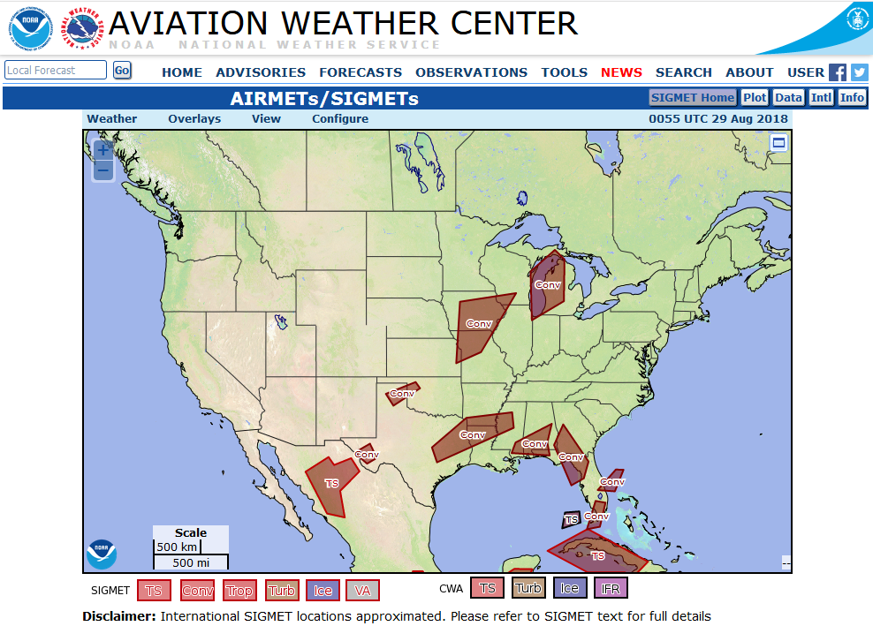
Aviation Weather Center
Convective SIGMET – Advises of hazards associated with thunderstorms
Includes line of thunderstorms, area of thunderstorms, and embedded or severe thunderstorms

Slide 15
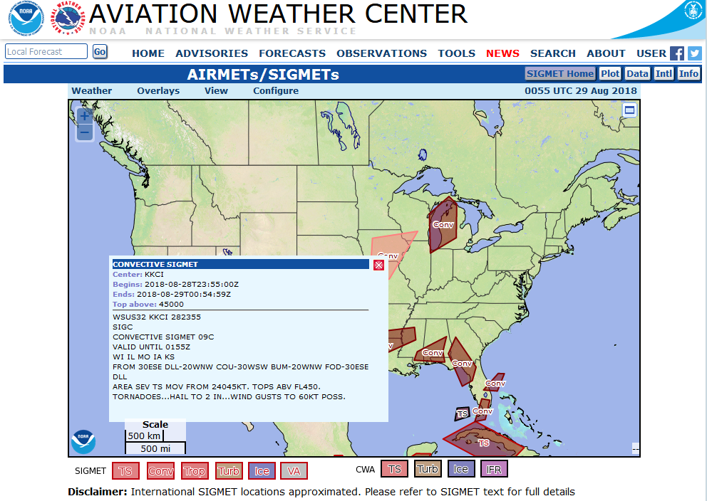
Aviation Weather Center
Any convective SIGMET imply severe or greater turbulence, severe icing, and low level wind shear

Slide 16
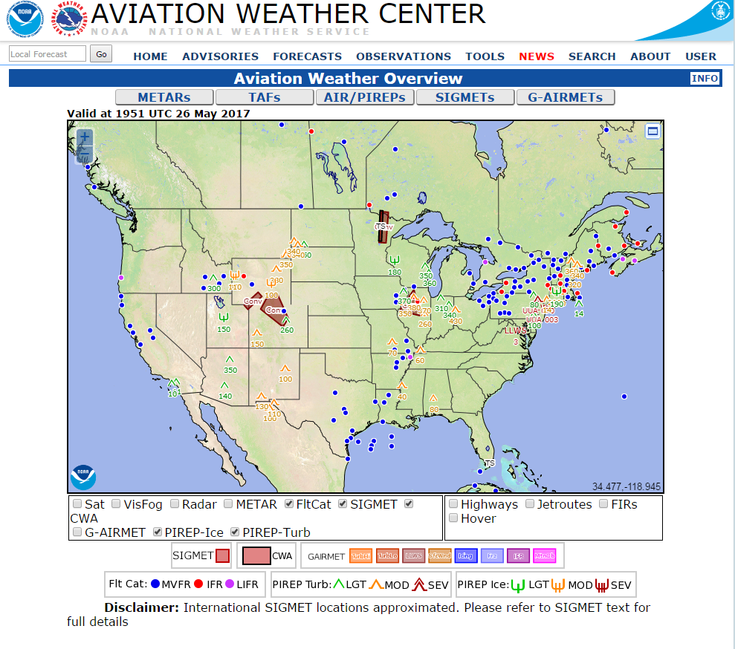
Useful TAF Products
www.aviationweather.gov

Slide 17
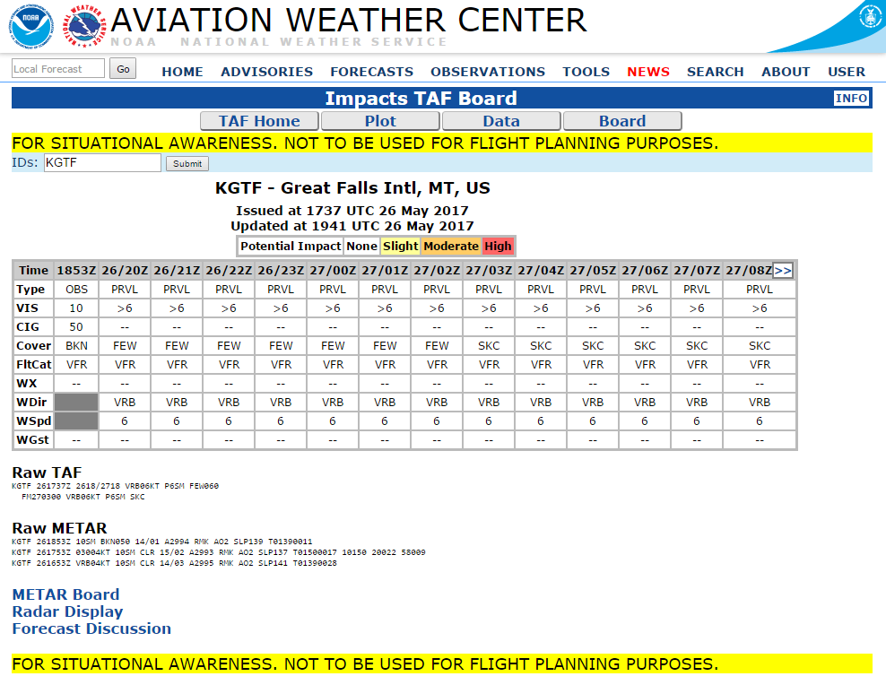
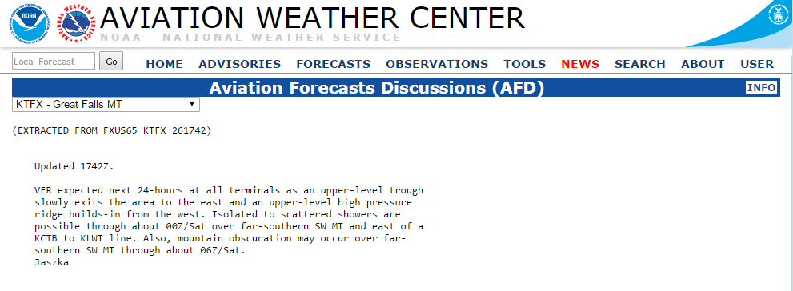
Useful Non-TAF Products

Slide 18
TAFs
Focus of NWS Local Office service to aviation community
Tackles most important aviation weather hazard: Weather for Take-Off and Landing
0-24hr (sometimes 30 hr) forecast of aviation-critical weather elements specific to 5 mile radius from center of airfield
Issued at least 4 times daily (some sites every 3 hours)
Amended as necessary – Most ASOS amended for wind, sky, visibility, and weather unless noted

Slide 19
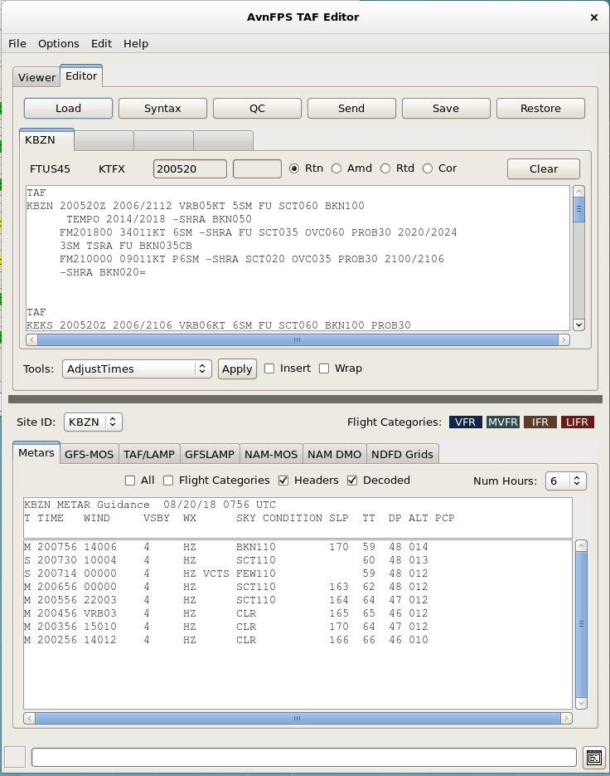
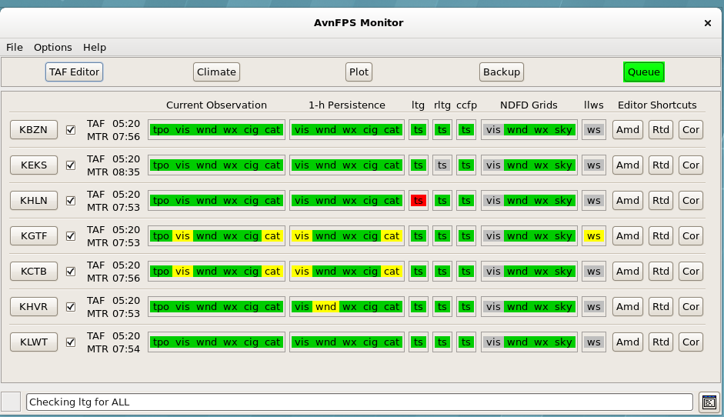
How Are TAFs Created
Forecasters use a program called AvnFPS to monitor and edit TAFs
Clicking on TAF Editor Opens the TAF Edit Interface
Notes:
Couple slides of the NWS process, could replace the next slide…

Slide 20
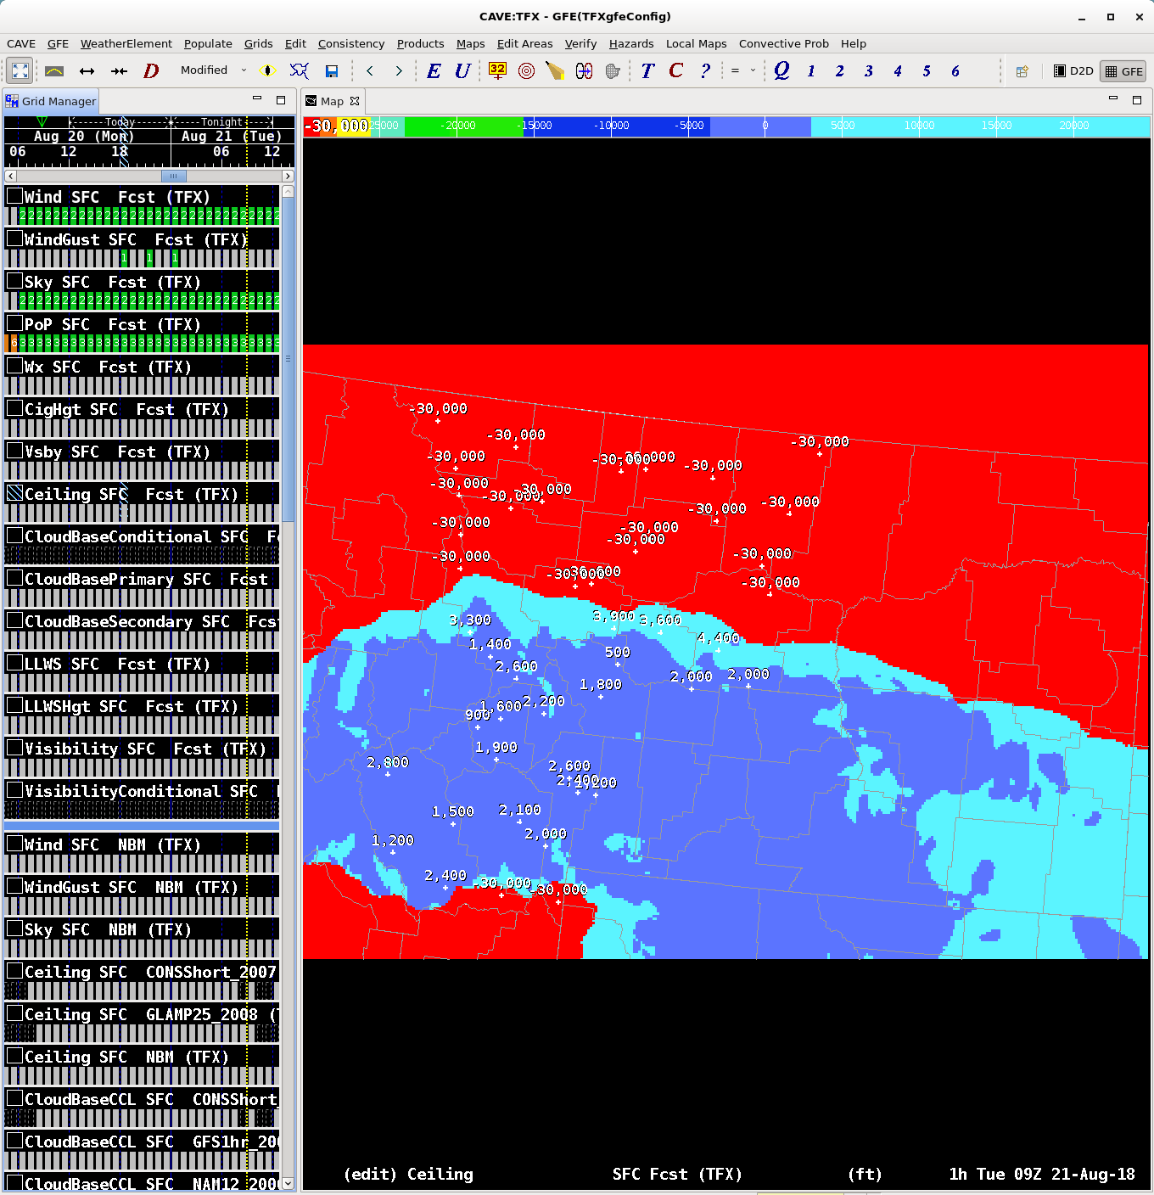
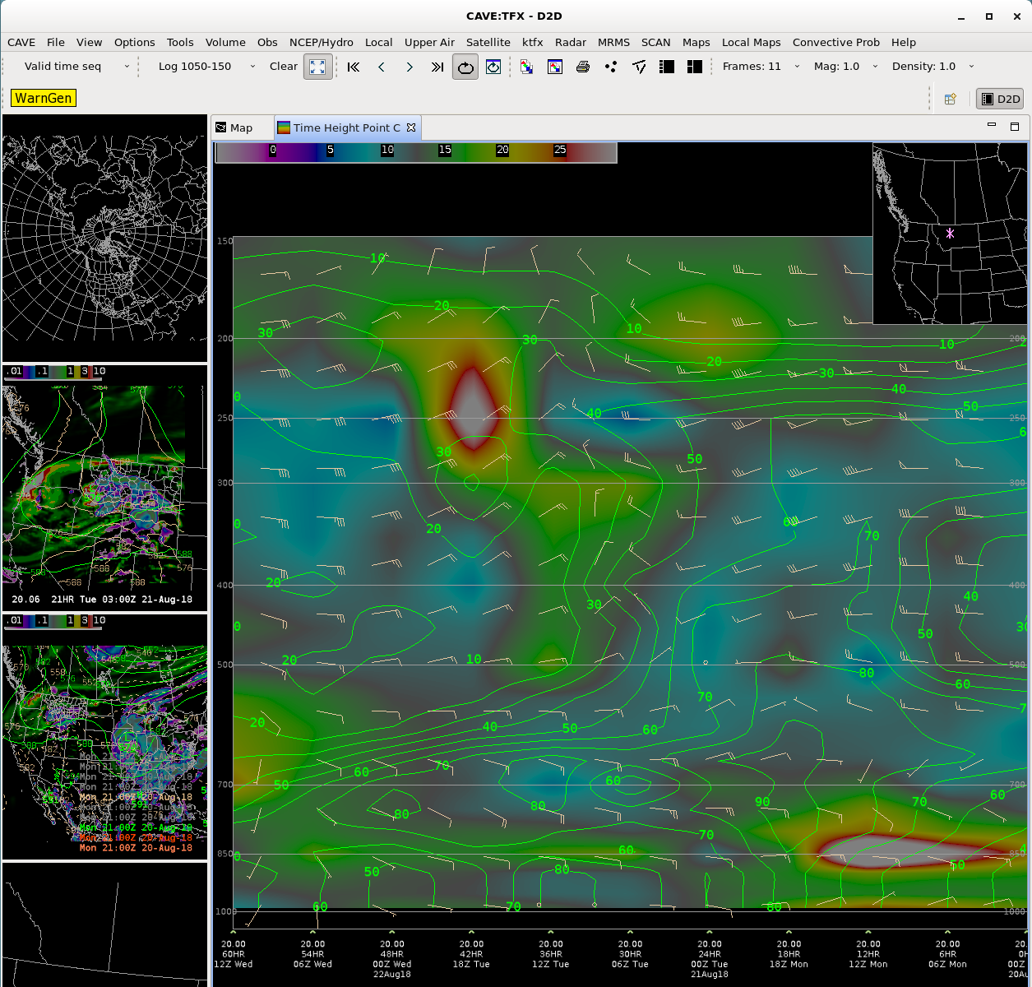
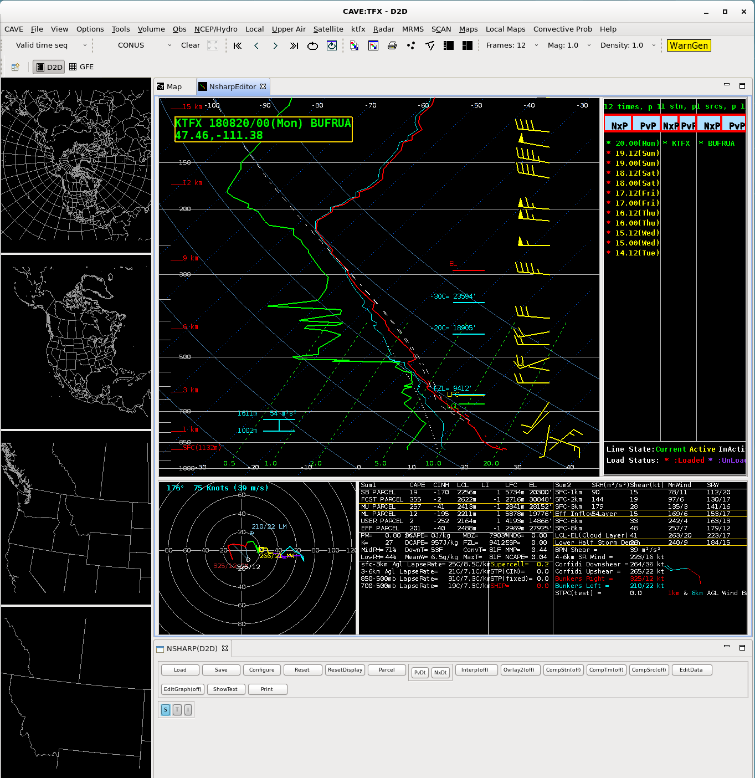
How Are TAFs Created
Forecasters then use a variety of methods to create TAFs
Some use new DAS methods
Some use Model Data
Some use model soundings
Notes:
Couple slides of the NWS process, could replace the next slide…

Slide 21
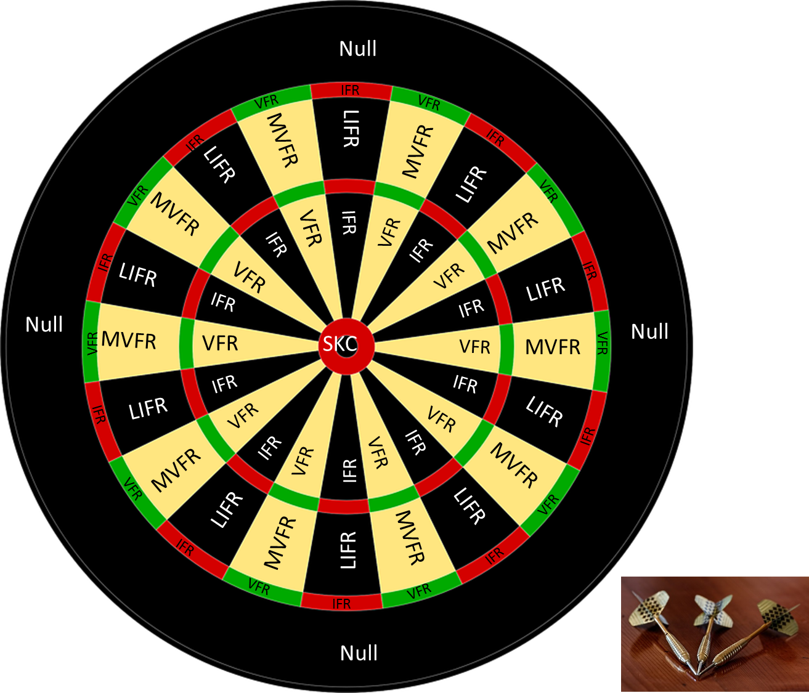
If all Else Fails….

Slide 22
Current TAF Format
TAF
KGTF 241732Z 2418/2518 23012G19KT 4SM -SHRA BKN060
TEMPO 2420/2423 VRB35G50KT 2SM -TSRA BKN030CB
FM242300 22006KT 3SM -SHRA OVC030
FM250600 250010KT 4SM –SHRA OVC050=
TAF issuance and valid dates. This example would be 24th of current month 18z to 25th of current month 18z. Usually always 24 hours unless amended.
Notes:
Format background

Slide 23
Current TAF Format
TAF
KGTF 241732Z 2418/2518 23012G19KT 4SM -SHRA BKN060
TEMPO 2420/2423 VRB35G50KT 2SM -TSRA BKN030CB
FM242300 22006KT 3SM -SHRA OVC030
FM250600 250010KT 4SM –SHRA OVC050=
Wind group: direction followed by speed in knots. VRB means variable and usually put with 06 Knots or less. WS means wind shear.
Notes:
Format background

Slide 24
Current TAF Format
TAF
KGTF 241732Z 2418/2518 23012G19KT 4SM -SHRA BKN060
TEMPO 2420/2423 VRB35G50KT 2SM -TSRA BKN030CB
FM242300 22006KT 3SM -SHRA OVC030
FM250600 250010KT 4SM –SHRA OVC050=
Visibility and weather (if present). P6SM means > 6 SM expected. Weather can be anything including rain, thunderstorms, snow, fog, vicinity fog (VCFG) or showers (VCSH), and many more.
Notes:
Format background

Slide 25
Current TAF Format
TAF
KGTF 241732Z 2418/2518 23012G19KT 4SM -SHRA BKN060
TEMPO 2420/2423 VRB35G50KT 2SM -TSRA BKN030CB
FM242300 22006KT 3SM -SHRA OVC030
FM250600 250010KT 4SM –SHRA OVC050=
Sky cover in thousands or hundreds of feet. A number in only the far right would be in hundreds of feet. Thunderstorms will include a CB. SKC means sky clear otherwise you will see FEW (Few clouds), SCT (Scattered clouds), BKN (Broken clouds), and OVC (Overcast).
Notes:
Format background

Slide 26
Current TAF Format
TAF
KGTF 241732Z 2418/2518 23012G19KT 4SM -SHRA BKN060
TEMPO 2420/2423 VRB35G50KT 2SM -TSRA BKN030CB
FM242300 22006KT 3SM -SHRA OVC030
FM250600 250010KT 4SM –SHRA OVC050=
Tempo group are for short term changes in conditions, that are expected to last longer than a half hour. Limited to only the first 9-12 hours of the valid TAF period. Time format is similar to the top line time format, then will be followed by the expected change in weather.
Notes:
Format background

Slide 27
Current TAF Format
TAF
KGTF 241732Z 2418/2518 23012G19KT 4SM -SHRA BKN060
TEMPO 2420/2423 VRB35G50KT 2SM -TSRA BKN030CB
FM242300 22006KT 3SM -SHRA OVC030
FM250600 250010KT 4SM –SHRA OVC050=
From Group (FM) is used for changing prevailing conditions and will include all required elements. Time format is DDHHHH, or date and hour.
Notes:
Format background

Slide 28
Current TAF Format
TAF
KGTF 241732Z 2418/2518 23012G19KT 4SM -SHRA BKN060
TEMPO 2420/2423 VRB35G50KT 2SM -TSRA BKN030CB
FM242300 22006KT 3SM -SHRA OVC030
FM250600 250010KT 4SM –SHRA OVC050=
Equal Sign (=) means the end of TAF.
Notes:
Format background

Slide 29
What Is PROB30?
TAF
KGTF 241732Z 2418/2518 230012G19KT 4SM -SHRA BKN060
TEMPO 2420/2423 VRB35G50KT 2SM -TSRA BKN030CB
FM242300 22006KT 3SM -SHRA OVC030
FM250600 250010KT 4SM –SHRA OVC050
PROB30 2504/2506 1SM –SN BKN010
PROB30 groups are used to convey a 30 percent chance of a certain change in prevailing conditions. The time format is similar to Tempo Groups with DDHH/DDHH. What follows is the condition that has a 30% chance of occurring instead of the prevailing conditions. Can be used anytime after the first 9 hours of the valid TAF.
Notes:
Format background

Slide 30
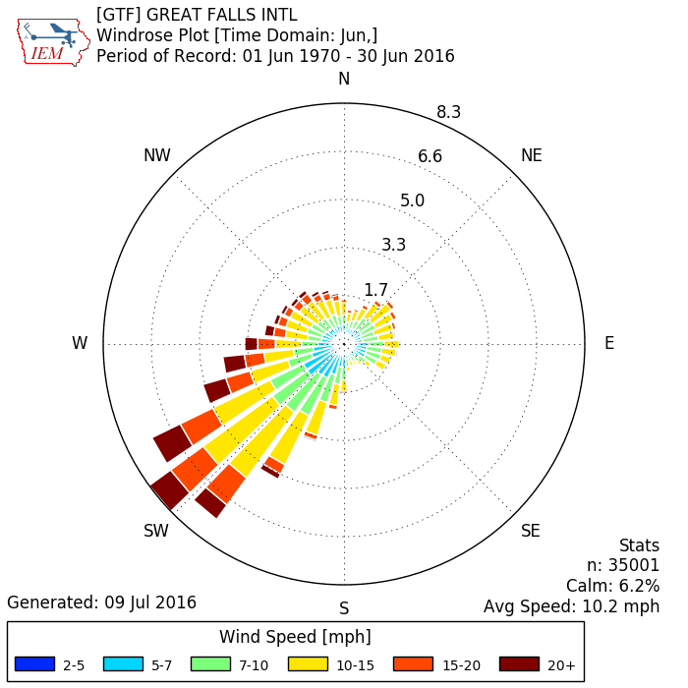
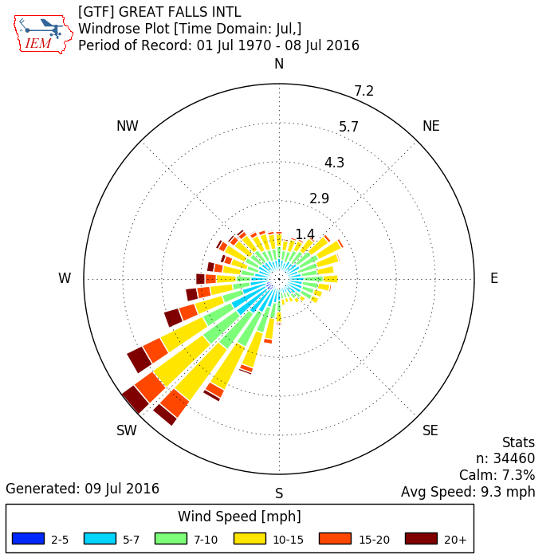
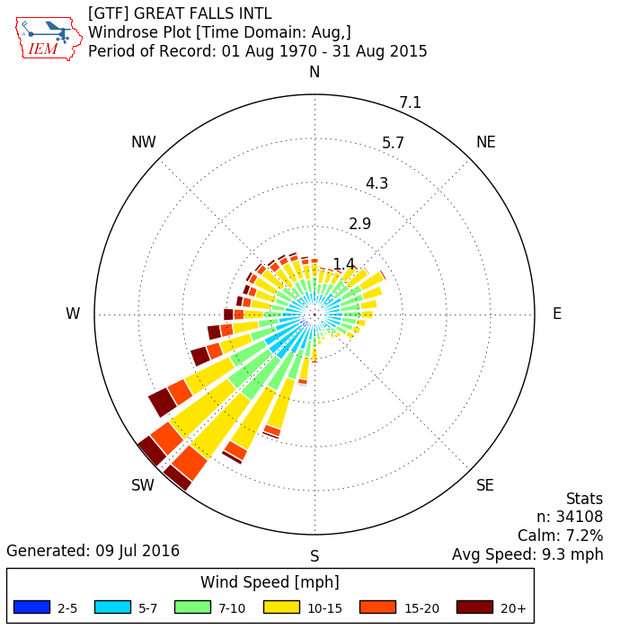
Know Your Winds
Prevailing Wind for the Summer

Slide 31
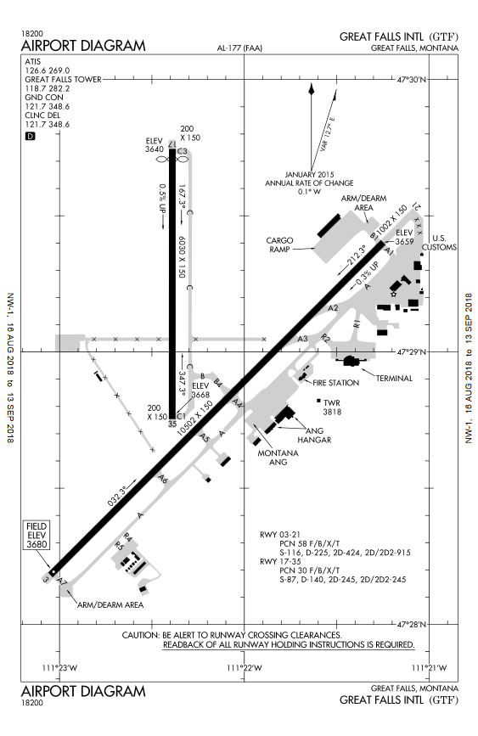
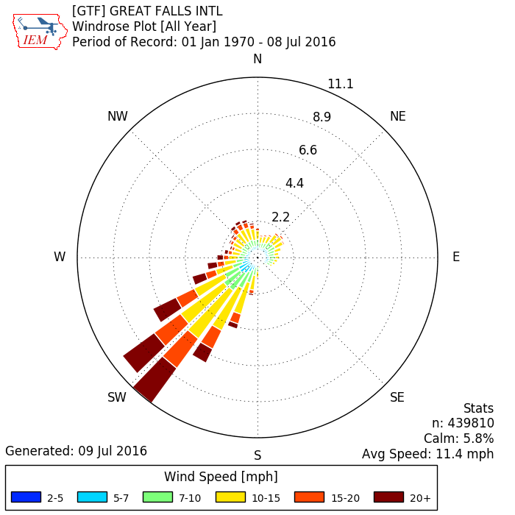
Know Your Winds
Prevailing Wind

Slide 32
Thunderstorms

Slide 33
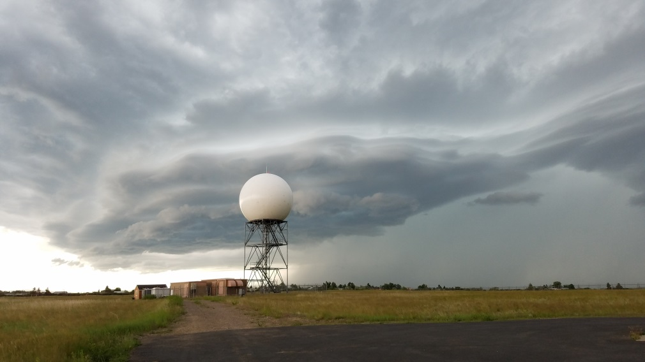
Thunderstorms
May occur anytime in the mountain west, but most common in afternoon / evening during spring, summer, and into fall
Require warm, humid air that becomes unstable when lifted upward
Generally ½ hour to 2 hours life-cycle

Slide 34
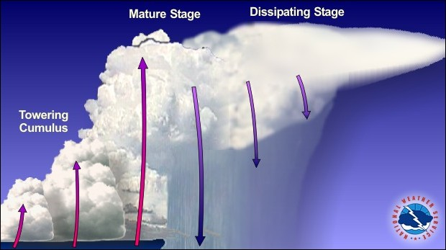
Multi-cell Thunderstorms
Possible Hazards:
Lightning
Gusty winds
Torrential rain
Small hail – (GR)
Usually not severe, but bears watching:
Possible flash flooding if stationary
May evolve into a Supercell thunderstorm
NWS Jetsream – Online School for Weather

Slide 35
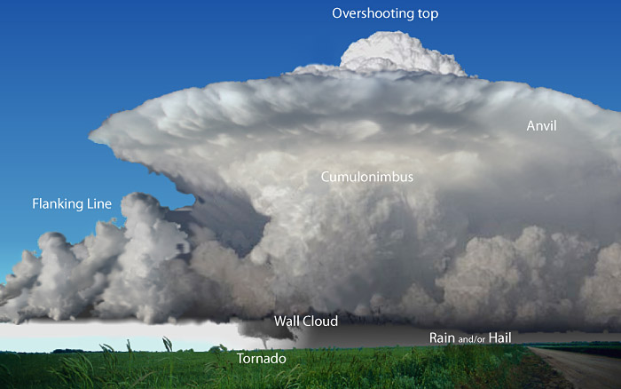
Supercell Thunderstorms
Hazards:
Lightning
Damaging winds
Torrential rain
Large hail
Possible Tornado
Rotating central core – “mesocyclone”
Can produce severe weather
Wind gusts 58 mph (50 kts) or higher
1-inch diameter hail (size of a quarter) or larger
Tornado
NWS Jetsream – Online School for Weather

Slide 36
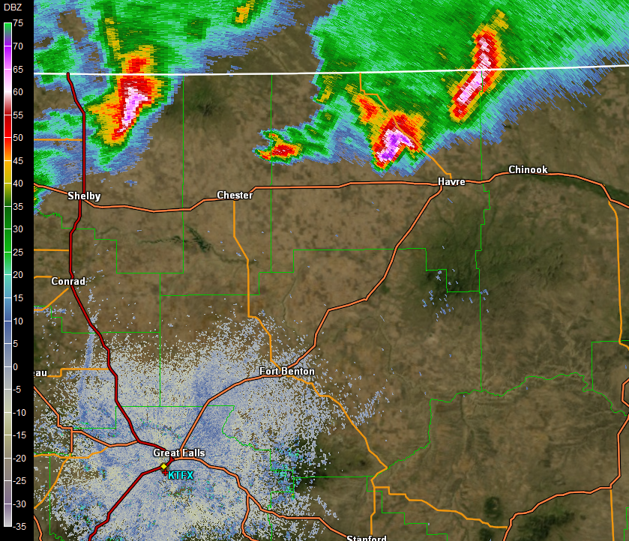
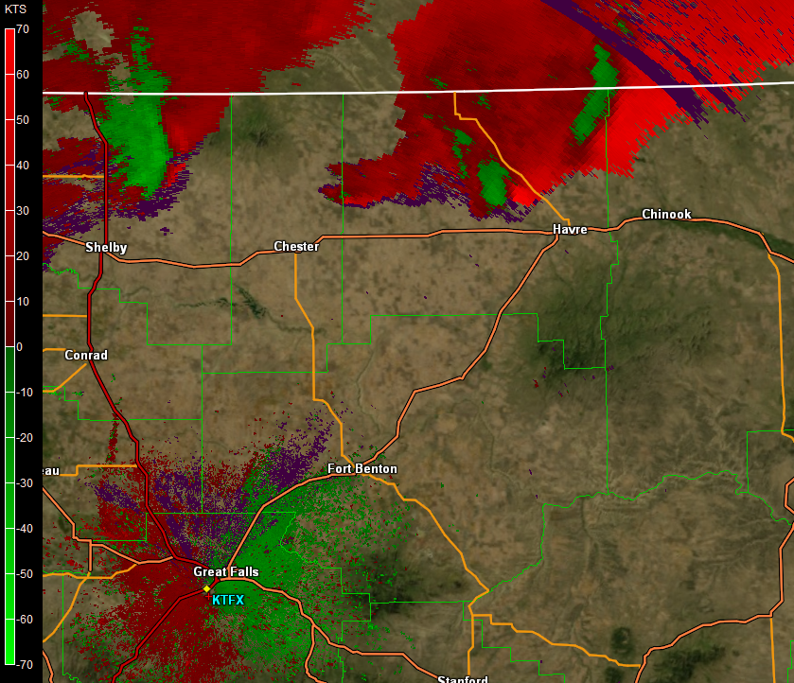
Thunderstorms on Radar
9:36pm July 4 2015
Doppler Velocity
Radar Reflectivity
Notes:
We could see lightning from the office at night. Doppler velocity indicates rotation in upper part of storm (above ~10k feet). Spotter reports a crucial to inform our messaging!

Slide 37
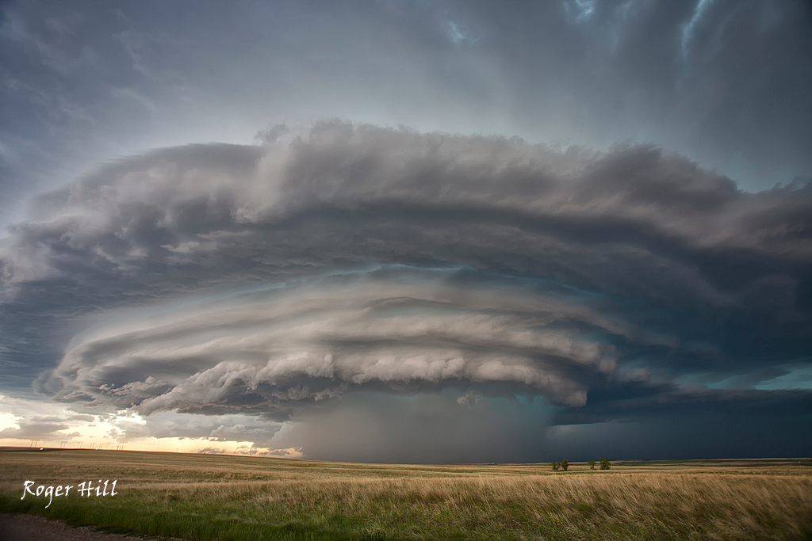
Montana Supercell
Radar
Spotter
Roger Hill, Silverlining Tours. North-central MT, June 4th 2012

Slide 38
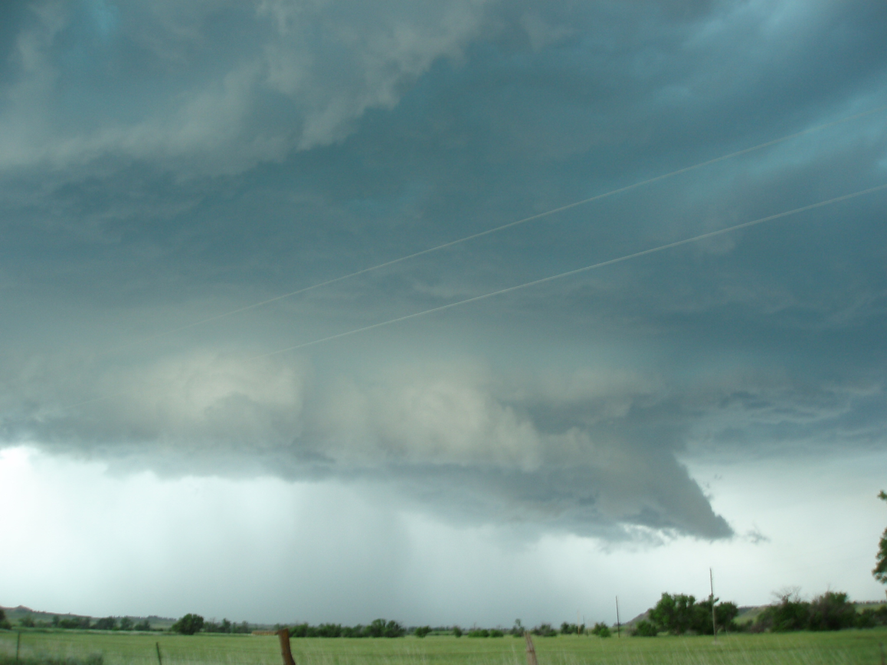
Wall Clouds
Lowering of cloud base near trailing edge of a mature Supercell
Marks condensation at point of strongest inflow
Sometimes rotates with mesocyclone
Lots of “scud” lifting into wall cloud; transient activity that falsely looks like funnels
Marie Smith, near Lame Deer MT
Watch for funnel clouds or tornado (near black arrow)

Slide 39
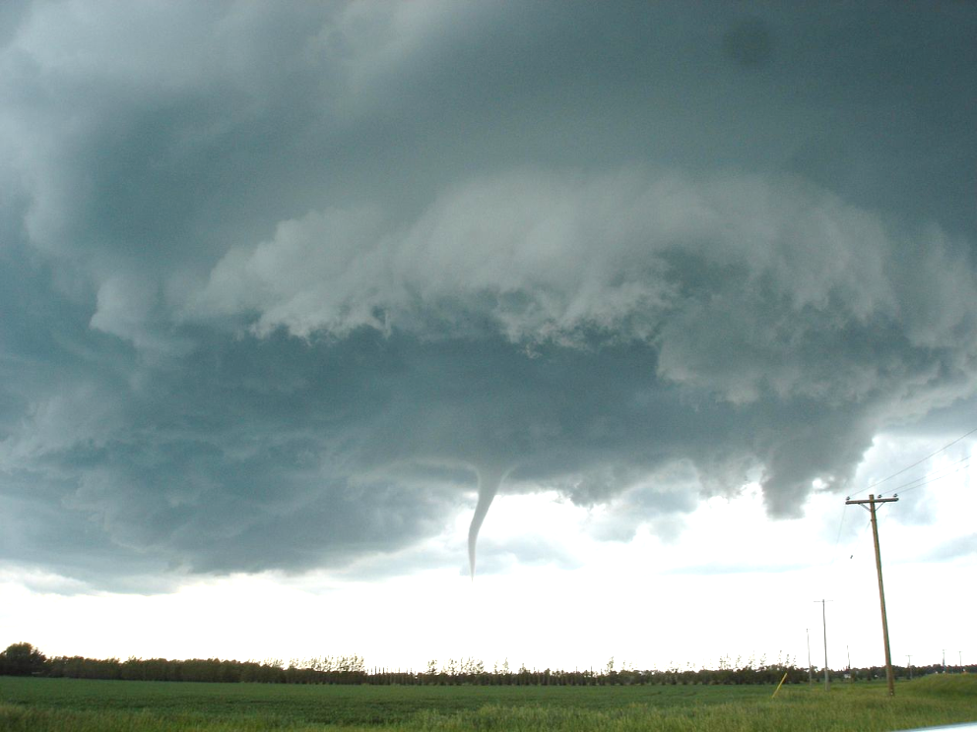
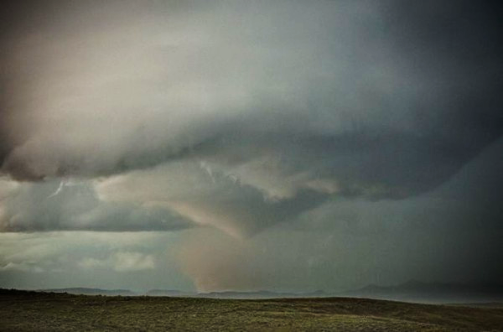
Funnel Cloud Yes, a Tornado
Funnel Cloud or Tornado??
Debris!
Justin1569 (Justin Hobson) at en.wikipedia
Roger Hill, stormchase.net. Broadus MT June 21st, 2010
Not reaching the surface
Possible Precursor to tornado
Describe its behavior when reporting
Updraft clouds often look like funnels
Must see evidence for contact with ground
Condensation funnel may not reach the ground in dry environments

Slide 40
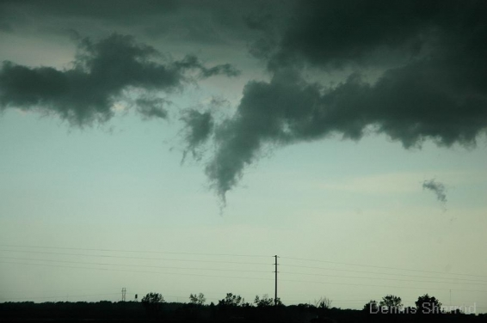
Scud
“Scud” is common near thunderstorms
Visible tracers for both updraft and gust front
May look like funnel clouds, but are transient, ragged, and not attached to anything
If you think it’s a funnel, watch it for a minute
Also called “fractus”
Dennis Sherrod, Vortex-2. June 1 2010.

Slide 41
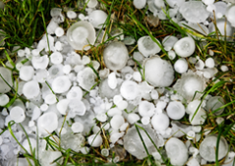
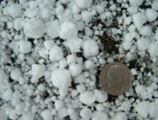
Hail (GR) Snow Pellots (GS)
Hail vs Ice Pellets
*NEW 2018*
GS will now only indicate snow pellets
GR will be ALL hail sizes. Hail 1/4” or greater will be noted in the remarks of a METAR
Sleet will still be PL (Ice Pellots)
Occur when raindrops or hail embryos cycle through a storm and fall as ice
Normally associated with a thunderstorm
Usually around 1/4” or greater
Soft small pellets of ice created when super cooled water droplets coat a snowflake (not sleet or PL)
Mostly found in spring or fall shallow convective showers
Usually a 1/4” or less

Slide 42
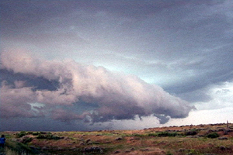
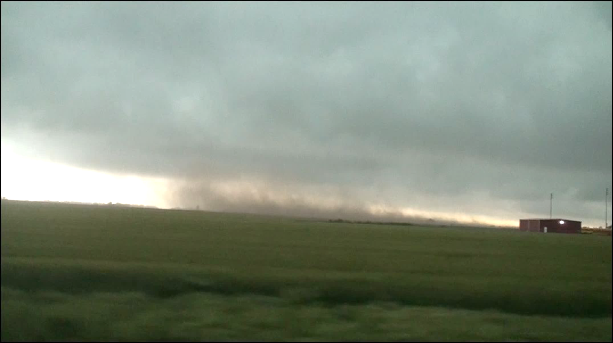
Shelf Cloud / Microburst / Gust Front
A gust front forms as rain-cooled air rushes out ahead of thunderstorm
The gust front lifts warm, humid air to form a shelf cloud
Not a wall cloud!
Will be followed by strong straight-line wind and hail or heavy rain
Strong winds may push dust, or cause damage
Could spin up a “gustnado”
Often marks late stages of Supercell
Roger Hill, stormchase.net. Near Lame Deer MT June 8th, 2006
Danny Niel, Northern Illinois Storm Chaser

Slide 43
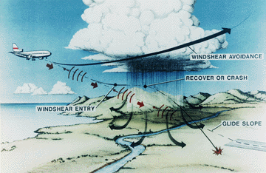
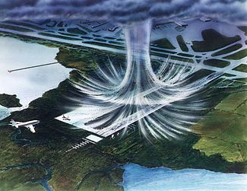
Microburst
Microburst are a sudden, and sometimes powerful, gust of wind associated with down drafts of a thunderstorm
747 Image Courtesy www.airportspotting.com

Slide 44
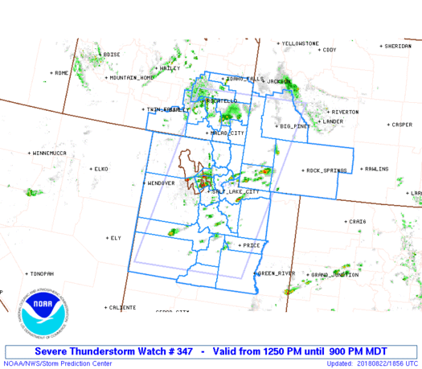
Severe Products
Watches vs Warnings
WATCH – ALERT product – Conditions are favorable for the event to occur. Warnings or advisories may become necessary (heads up)
Notes:
(talk about aviation and severe warnings here)

Slide 45
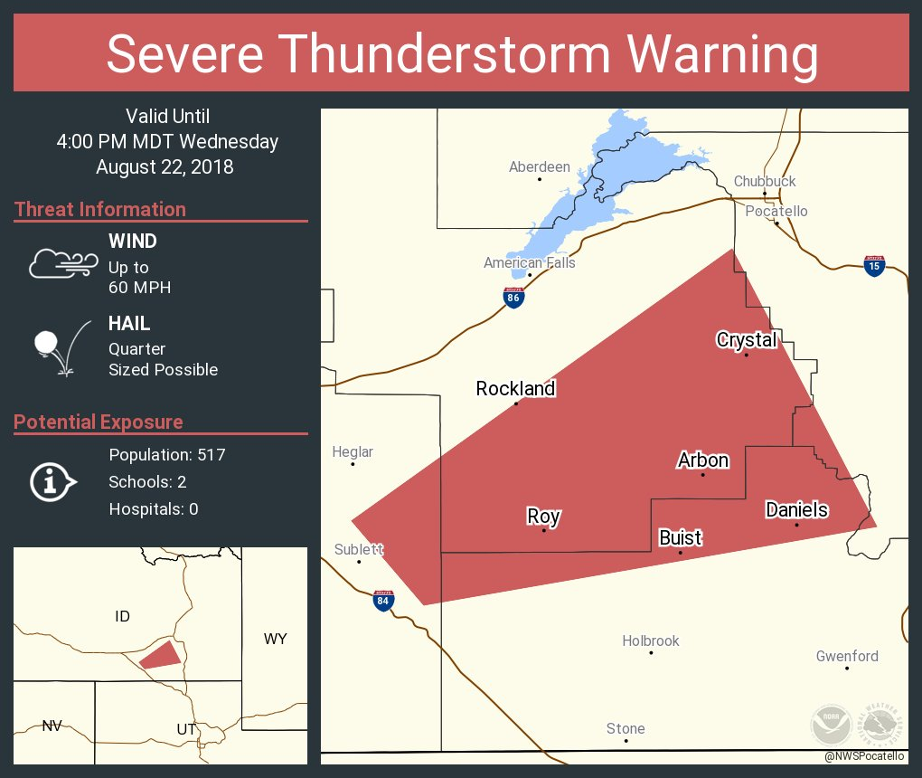
Severe Products
WARNING – ACTION product – Event occurring or high likelihood of occurring soon. Take appropriate action to protect life & property
Airport Weather Warning – Locally negotiated between NWS Offices and Airports. Only to alert ground crews. Check with your local office for more details
Watches Vs Warnings
Notes:
(talk about aviation and severe warnings here), put AWW example here

Slide 46
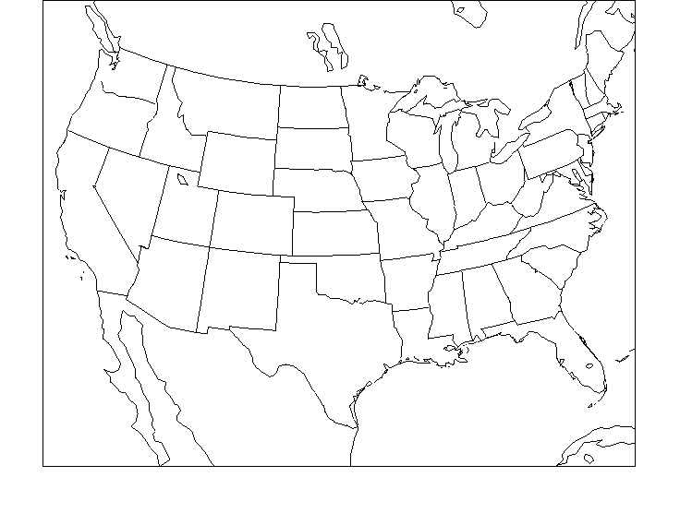
Meteorology 101
H
L
Reality is more complicated
Wind flow around highs and lows

Slide 47
Meteorology 101
L
Rising Air near ows
Rising air cools; water vapor in the air condenses to form clouds/precipitation
Lows tend to bring cloudy, wet weather
Sinking air warms and dries out.
Highs tend to bring fair, dry weather.
Sinking air near ighs
H

Slide 48
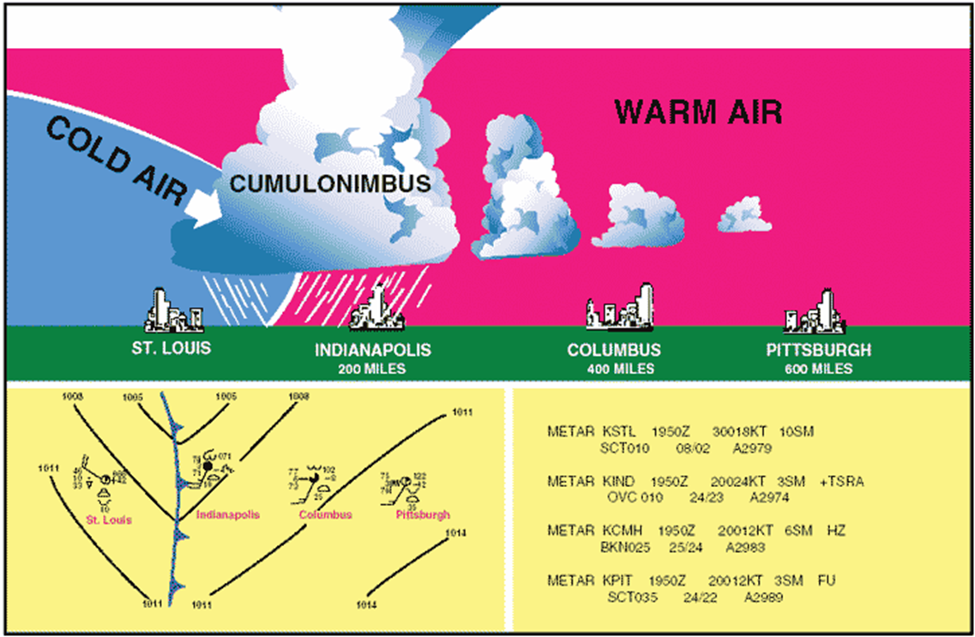
Cold Fronts
Simple 3-D idea:

Slide 49
Warm Fronts
Simple 3-D idea:

Slide 50
Turbulence
Turbulence with jet streams often occurs above all clouds (Clear Air Turbulence or CAT)
Sloping tropopause areas can cause turbulence
Abrupt wind shifts can cause turbulence
Turbulence can also occur along frontal boundaries
Tropopause is the boundary between the troposphere and the stratosphere
Averages between 29.5 kft and 36.1 kft
Notes:
Jet stream and turbulence

Slide 51
Wind Hazards

Slide 52
Downslope (Chinook) Winds
As air descends the east side of the Continental Divide, it becomes warmer and drier while also accelerating due to gravity
Along the Rocky Mountain Front, this is often called a Chinook Wind

Slide 53
Typical Western US Downslope Winds

Slide 54
Downslope (Chinook) Winds
Air flows over mountains like a wave and during Chinook winds, it is common to see a “Chinook Arch”.
This cloud forms when moisture from west of the divide pushes east of the divide.
Courtesy: NWS
Notes:
As air flows over a mountain range, it tends to behave like a wave as it moves up and down several times over and downwind of the mountain range. This wavy airflow is called a mountain wave. As the mountain wave rises again, just beyond the mountain range, the rising air expands, cools, and may condense into an extensive cloud band known as a Chinook Arch. A Chinook Arch often has a laminar (i.e. smooth appearance) and a sharp western edge facing the mountains. This cloud formation also indicates the presence of turbulence and strong downslope winds.

Slide 55
Mountain Wave Clouds
Notes:
Need a lenticular picture

Slide 56
Upslope Precipitation
Upslope precipitation occurs when moist airflow encounters higher terrain and is forced to rise.
As this moist air rises, it cools and condenses to produce clouds and precipitation.

Slide 57
Putting It Together
Upslope precipitation occurs along the windward side of the mountains and may result in significant amounts of rain or snow.
Downslope flow on the leeward side of the mountains typically results in mild, dry, and windy conditions.
This situation can cause motorists to encounter rapid changes in weather and road conditions while traveling over a mountain pass.

Slide 58
Typical Western U.S. Down-slope Winds

Slide 59
Winter Weather Hazards

Slide 60
There’s A Winter What Issued?
WARNING = Severe weather occurring or about to occur
WATCH = Conditions favorable for severe weather in watch area
ADVISORY = Non-severe, nuisance weather occurring or about to occur

Slide 61
There’s A Winter What Issued?
“high impact expected”
“big storm”
“early heads-up”
WARNING = Severe weather occurring or about to occur
WATCH = Conditions favorable for severe weather in watch area
“moderate impact expected”
“typical storm”
ADVISORY = Non-severe, nuisance weather occurring or about to occur

Slide 62
Freezing and Sleet
Definition: The accumulation of liquid water on frozen surfaces
Any amount of freezing rain can be dangerous

Slide 63
Sudden Changes: Snow Bands
Often times localized
Can produce inches of snow over short time periods
Photo: NWS Missoula

Slide 64
Blizzards and Blowing Snow
Courtesy: Montana Department of Transportation
What is a blizzard?
Dangerous and
life-threatening!
Sustained wind or frequent gusts to 35 mph or higher
Visibility < ¼ mile due to considerable blowing and/or falling snow
Conditions must prevail for at least 3 consecutive hours
Courtesy: Glacier National Park, Saint Mary Webcam

Slide 65
Aviation Weather Safety
Questions??
Roger Martin
National Weather Service
Wichita, KS
roger.martin@noaa.gov
Jason Anglin
National Weather Service
Great Falls, MT
jason.anglin@noaa.gov

